Slide 1


Slide 2















Slide 3





















Slide 4























Slide 5









Slide 6















Slide 7









Slide 8
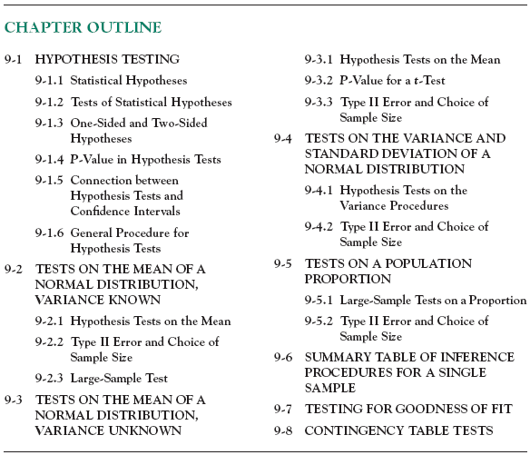

Slide 9
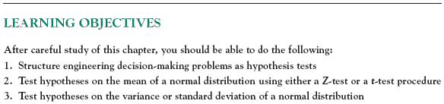

Slide 10
9-1 Hypothesis Testing
9-1.1 Statistical Hypotheses
Statistical hypothesis testing and confidence interval estimation of parameters are the fundamental methods used at the data analysis stage of a comparative experiment, in which the engineer is interested, for example, in comparing the mean of a population to a specified value.
Definition

Slide 11






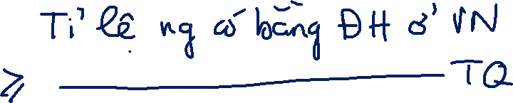












Slide 12
9-1 Hypothesis Testing
9-1.1 Statistical Hypotheses
For example, suppose that we are interested in the burning rate of a solid propellant used to power aircrew escape systems.
Now burning rate is a random variable that can be described by a probability distribution.
Suppose that our interest focuses on the mean burning rate (a parameter of this distribution).
Specifically, we are interested in deciding whether or not the mean burning rate is 50 centimeters per second.

Slide 13

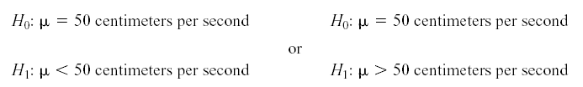


9-1 Hypothesis Testing
9-1.1 Statistical Hypotheses
Two-sided Alternative Hypothesis
null hypothesis
alternative hypothesis
One-sided Alternative Hypotheses

Slide 14
9-1 Hypothesis Testing
9-1.1 Statistical Hypotheses
Test of a Hypothesis
A procedure leading to a decision about a particular hypothesis
Hypothesis-testing procedures rely on using the information in a random sample from the population of interest.
If this information is consistent with the hypothesis, then we will conclude that the hypothesis is true; if this information is inconsistent with the hypothesis, we will conclude that the hypothesis is false.

Slide 15

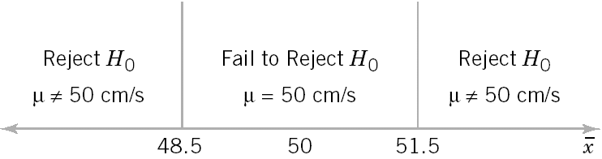
9-1 Hypothesis Testing
9-1.2 Tests of Statistical Hypotheses
Figure 9-1 Decision criteria for testing H₀:μ = 50 centimeters per second versus H₁:μ ≠ 50 centimeters per second.

Slide 16
9-1 Hypothesis Testing
9-1.2 Tests of Statistical Hypotheses
Definitions

Slide 17
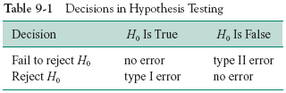
9-1 Hypothesis Testing
9-1.2 Tests of Statistical Hypotheses
Sometimes the type I error probability is called the significance level, or the α-error, or the size of the test.

Slide 18



















Slide 19




























Slide 20











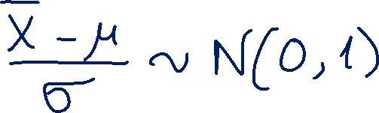







Slide 21
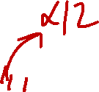


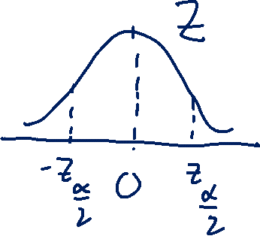
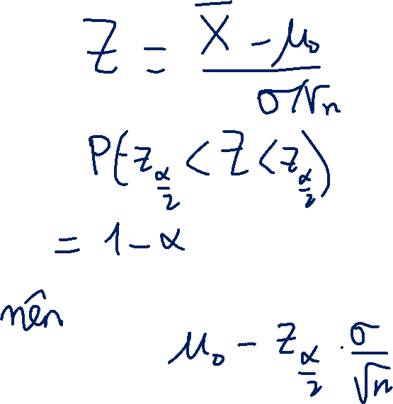








Slide 22































Slide 23
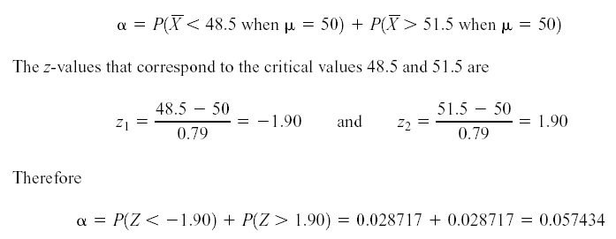
9-1 Hypothesis Testing
9-1.2 Tests of Statistical Hypotheses

Slide 24
9-1 Hypothesis Testing

Slide 25












9-1 Hypothesis Testing
Figure 9-3 The probability of type II error when μ = 52 and n = 10.

Slide 26

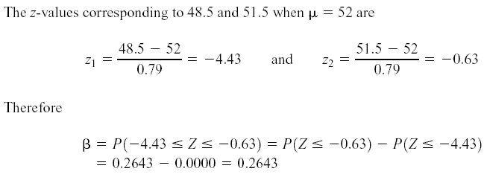
9-1 Hypothesis Testing

Slide 27
9-1 Hypothesis Testing
Figure 9-4 The probability of type II error when μ = 50.5 and n = 10.

Slide 28
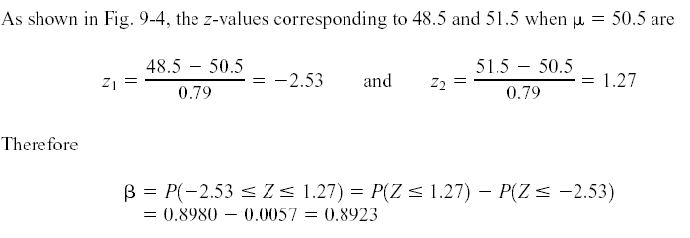
9-1 Hypothesis Testing

Slide 29
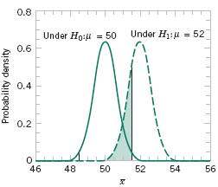
9-1 Hypothesis Testing
Figure 9-5 The probability of type II error when μ = 2 and n = 16.

Slide 30
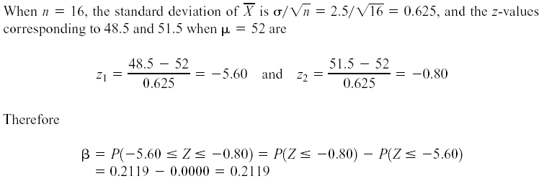
9-1 Hypothesis Testing

Slide 31
9-1 Hypothesis Testing

Slide 32
9-1 Hypothesis Testing
Definition
The power is computed as 1 - β, and power can be interpreted as the probability of correctly rejecting a false null hypothesis. We often compare statistical tests by comparing their power properties.
For example, consider the propellant burning rate problem when
we are testing H ₀ : μ = 50 centimeters per second against H ₁ : μ not equal 50 centimeters per second . Suppose that the true value of the mean is μ = 52. When n = 10, we found that β = 0.2643, so the power of this test is 1 - β = 1 - 0.2643 = 0.7357 when μ = 52.

Slide 33














Slide 34


9-1 Hypothesis Testing
9-1.3 One-Sided and Two-Sided Hypotheses
Two-Sided Test:
One-Sided Tests:

Slide 35
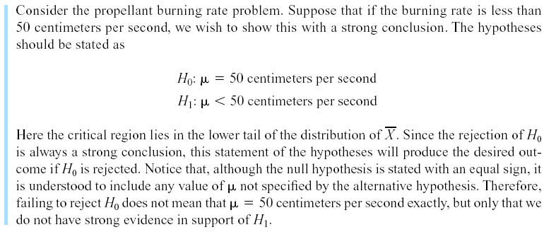
9-1 Hypothesis Testing
Example 9-1

Slide 36


9-1 Hypothesis Testing
The bottler wants to be sure that the bottles meet the specification on mean internal pressure or bursting strength, which for 10-ounce bottles is a minimum strength of 200 psi. The bottler has decided to formulate the decision procedure for a specific lot of bottles as a hypothesis testing problem. There are two possible formulations for this problem, either
or

Slide 37
9-1 Hypothesis Testing
9-1.4 P-Values in Hypothesis Tests
Definition

Slide 38

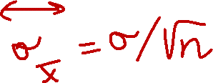







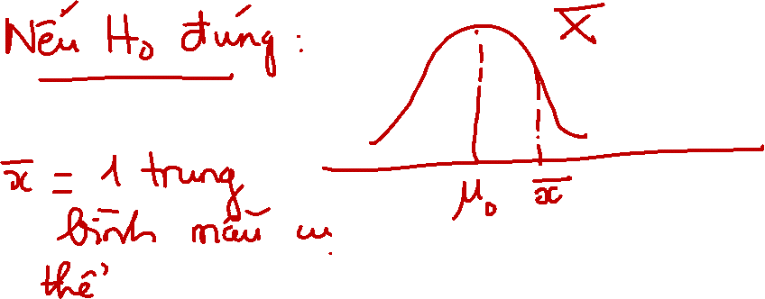





Slide 39
















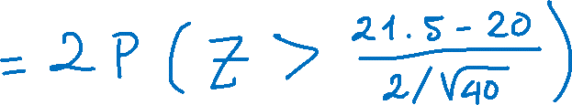



Slide 40



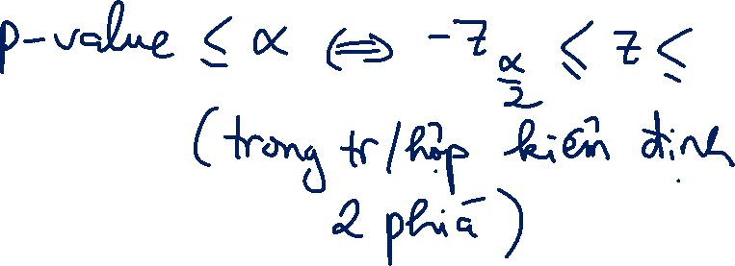








Slide 41
9-1 Hypothesis Testing
9-1.4 P-Values in Hypothesis Tests

Slide 42
9-1 Hypothesis Testing
9-1.4 P-Values in Hypothesis Tests

Slide 43
9-1 Hypothesis Testing
9-1.5 Connection between Hypothesis Tests and Confidence Intervals

Slide 44
9-1 Hypothesis Testing
9-1.6 General Procedure for Hypothesis Tests
1. From the problem context, identify the parameter of interest.
2. State the null hypothesis, H₀ .
3. Specify an appropriate alternative hypothesis, H₁.
4. Choose a significance level, α.
5. Determine an appropriate tst statistic.
6. State the rejection region for the statistic.
7. Compute any necessary sample quantities, substitute these into the equation for the test statistic, and compute that value.
8. Decide whether or not H₀ should be rejected and report that in the problem context.

Slide 45









9-2 Tests on the Mean of a Normal Distribution, Variance Known
9-2.1 Hypothesis Tests on the Mean
We wish to test:
The test statistic is:

Slide 46
9-2 Tests on the Mean of a Normal Distribution, Variance Known
9-2.1 Hypothesis Tests on the Mean
Reject H₀ if the observed value of the test statistic z₀ is either:
z₀ > z_{α/2} or z₀ < -z_{α/2}
Fail to reject H₀ if
-z_{α/2} < z₀ < z_{α/2}

Slide 47
9-2 Tests on the Mean of a Normal Distribution, Variance Known

Slide 48
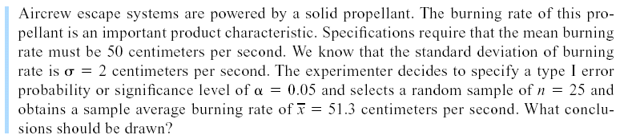










9-2 Tests on the Mean of a Normal Distribution, Variance Known
Example 9-2

Slide 49
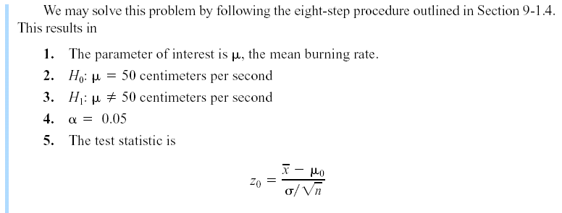
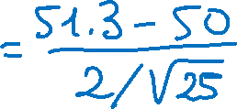

9-2 Tests on the Mean of a Normal Distribution, Variance Known
Example 9-2

Slide 50
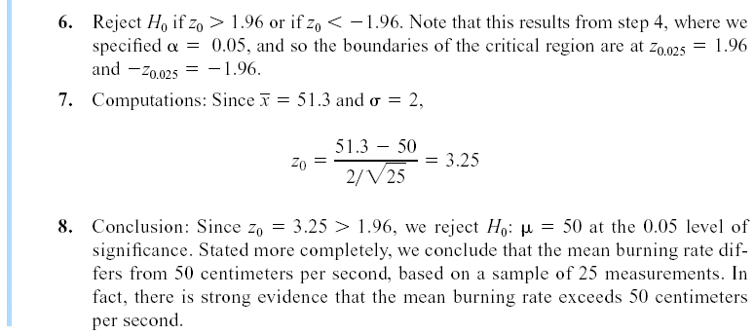
9-2 Tests on the Mean of a Normal Distribution, Variance Known
Example 9-2

Slide 51




























Slide 52
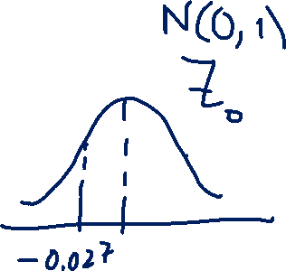












Slide 53
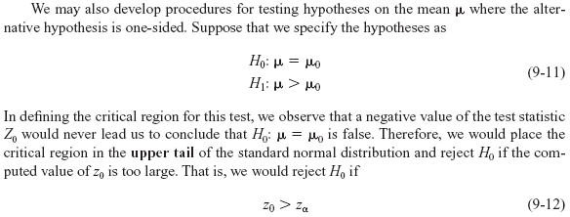
9-2 Tests on the Mean of a Normal Distribution, Variance Known
9-2.1 Hypothesis Tests on the Mean

Slide 54
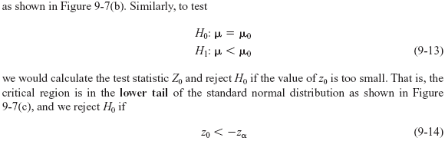
9-2 Tests on the Mean of a Normal Distribution, Variance Known
9-2.1 Hypothesis Tests on the Mean (Continued)

Slide 55
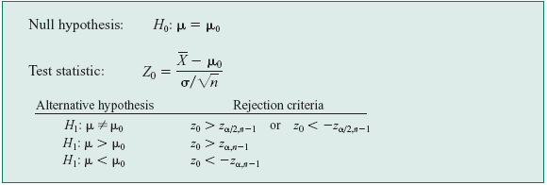





9-2 Tests on the Mean of a Normal Distribution, Variance Known
9-2.1 Hypothesis Tests on the Mean (Continued)

Slide 56

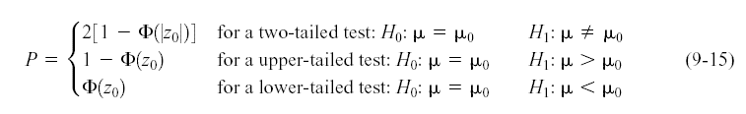
9-2 Tests on the Mean of a Normal Distribution, Variance Known
P-Values in Hypothesis Tests

Slide 57

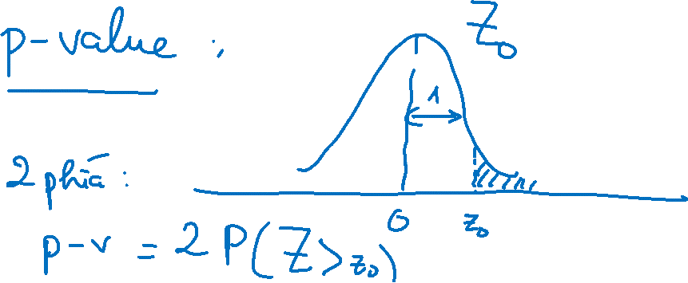



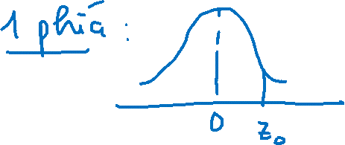




Slide 58









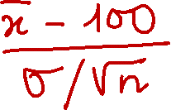

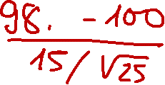





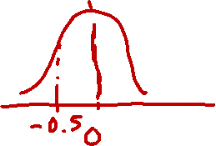











Slide 59




















Slide 60
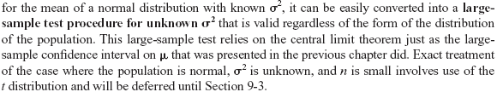
9-2 Tests on the Mean of a Normal Distribution, Variance Known
9-2.3 Large Sample Test

Slide 61




9-3 Tests on the Mean of a Normal Distribution, Variance Unknown
9-3.1 Hypothesis Tests on the Mean
One-Sample t-Test

Slide 62
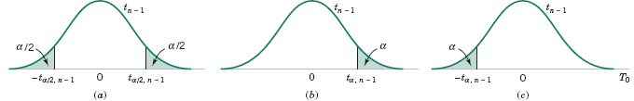
9-3 Tests on the Mean of a Normal Distribution, Variance Unknown
9-3.1 Hypothesis Tests on the Mean
Figure 9-9 The reference distribution for H₀: μ = μ₀ with critical region for (a) H₁: μ ≠ μ₀ , (b) H₁: μ > μ₀, and (c) H₁: μ < μ₀.

Slide 63
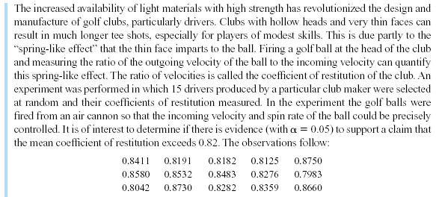

9-3 Tests on the Mean of a Normal Distribution, Variance Unknown
Example 9-6

Slide 64
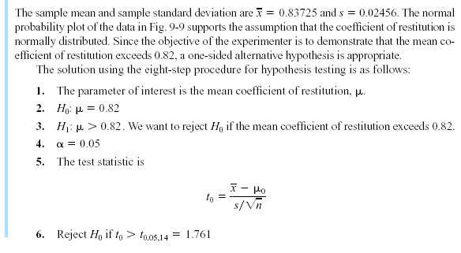
9-3 Tests on the Mean of a Normal Distribution, Variance Unknown
Example 9-6

Slide 65
9-3 Tests on the Mean of a Normal Distribution, Variance Unknown
Example 9-6
Figure 9-10 Normal probability plot of the coefficient of restitution data from Example 9-6.

Slide 66
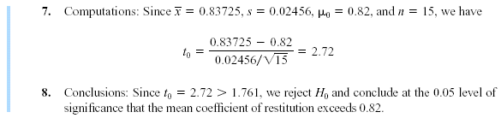
9-3 Tests on the Mean of a Normal Distribution, Variance Unknown
Example 9-6

Slide 67

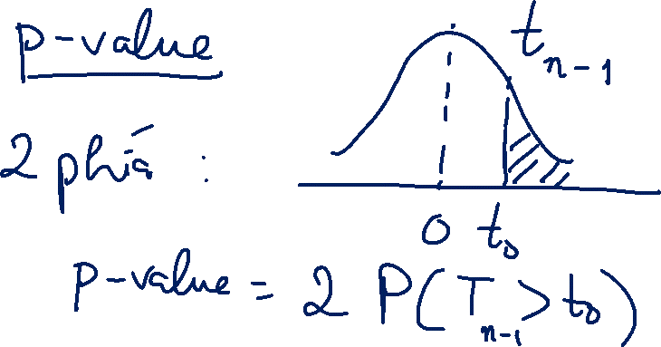





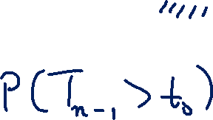
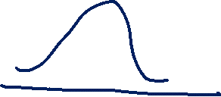

Slide 68



Slide 69
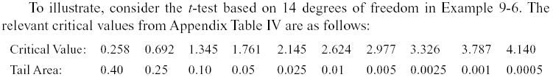
9-3 Tests on the Mean of a Normal Distribution, Variance Unknown
9-3.2 P-value for a t-Test
The P-value for a t-test is just the smallest level of significance at which the null hypothesis would be rejected.
Notice that t₀ = 2.72 in Example 9-6, and that this is between two tabulated values, 2.624 and 2.977. Therefore, the P-value must be between 0.01 and 0.005. These are effectively the upper and lower bounds on the P-value.

Slide 70
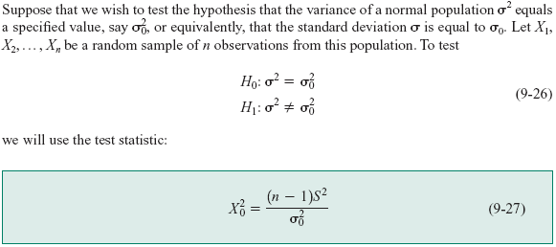


9-4 Hypothesis Tests on the Variance and Standard Deviation of a Normal Distribution
9-4.1 Hypothesis Test on the Variance

Slide 71
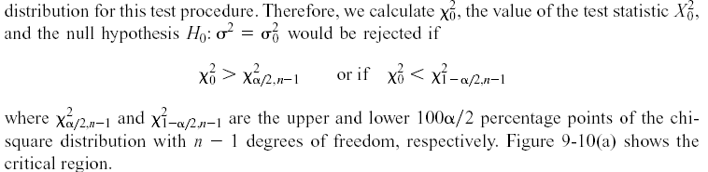
9-4 Hypothesis Tests on the Variance and Standard Deviation of a Normal Distribution
9-4.1 Hypothesis Test on the Variance

Slide 72
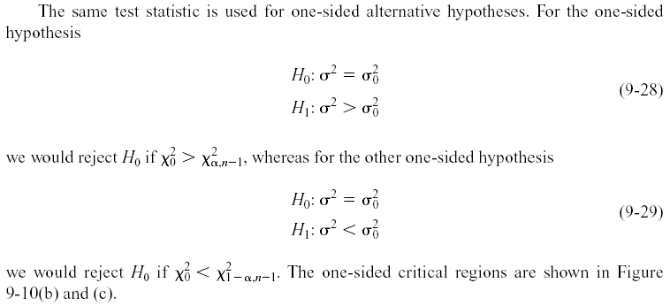
9-4 Hypothesis Tests on the Variance and Standard Deviation of a Normal Distribution
9-4.1 Hypothesis Test on the Variance

Slide 73
9-4 Hypothesis Tests on the Variance and Standard Deviation of a Normal Distribution
9-4.1 Hypothesis Test on the Variance

Slide 74
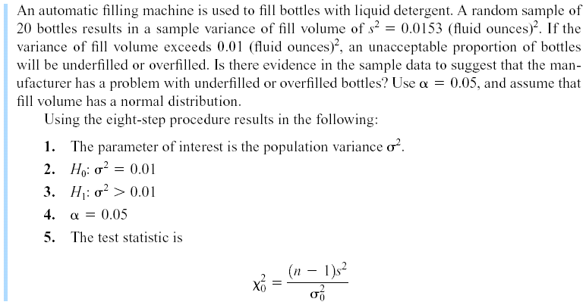
9-4 Hypothesis Tests on the Variance and Standard Deviation of a Normal Distribution
Example 9-8

Slide 75
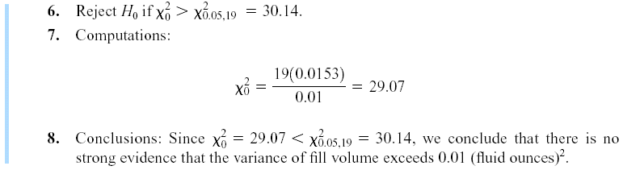
9-4 Hypothesis Tests on the Variance and Standard Deviation of a Normal Distribution
Example 9-8

Slide 76


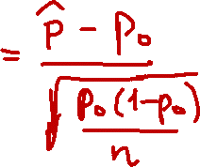

9-5 Tests on a Population Proportion
9-5.1 Large-Sample Tests on a Proportion
Many engineering decision problems include hypothesis testing about p.
An appropriate test statistic is

Slide 77


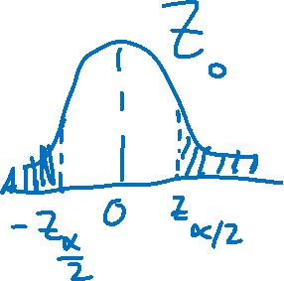












Slide 78


9-5 Tests on a Population Proportion
Example 9-10

Slide 79






9-5 Tests on a Population Proportion
Example 9-10

Slide 80


9-5 Tests on a Population Proportion
Another form of the test statistic Z₀ is
or

Slide 81






























Slide 82





















Slide 83


